Slide 1
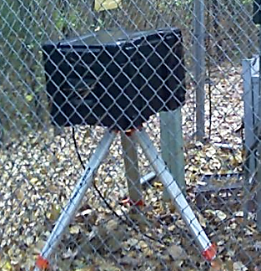
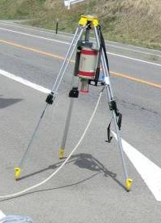
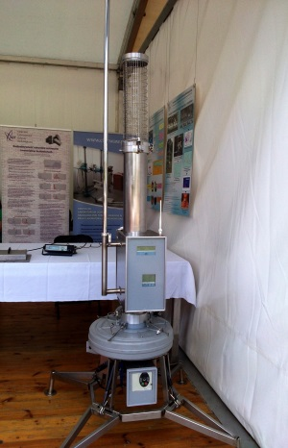
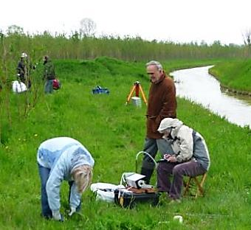
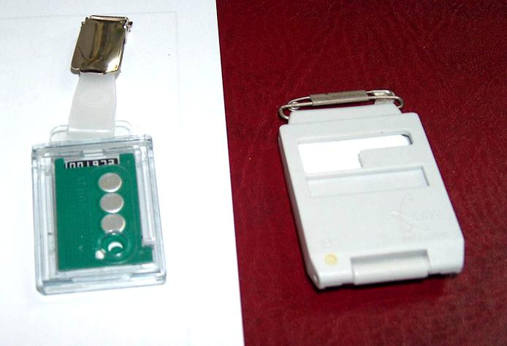
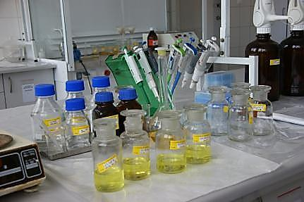
General concept and methodology for a baseline of environmental conditions in foreseen location of NPP
PAWEŁ KRAJEWSKI
CENTRAL LABORATORY FOR RADIOLOGICAL PROTECTION

Slide 2
REQUIREMENT
  The site selection and evaluation process was developed based on the Polish regulations, the international guidelines and best practices, with the support of engineering consultants with extensive, documented experience in supporting NPP site selection and management of nuclear power projects and investments. Development of the site selection and evaluation process was based on the following documents:
 |  | The Atomic Law A Council of Ministers Regulation on the detailed scope of assessment of the location intended for a nuclear facility, the cases where such location must not be considered as meeting the requirements for location of the nuclear facility and on requirements for a location report for the nuclear facility (J.o.L. of 2012, item 1025) IAEA NS-R-3, Site Evaluation for Nuclear Installations, Safety Requirements, November 2003 IAEA NS-G-3.1, External Human Induced Events in Site Evaluation for Nuclear Power Plants, Safety Guide, May 2002 IAEA NS-G-3.2, Dispersion of Radioactive Material in Air and Water and Consideration of Population Distribution in Site Evaluation for Nuclear Power Plants, Safety Guide, March 2002 IAEA NS-G-3.3, Evaluation of Seismic Hazards for Nuclear Power Plants, Safety Guide, December 2002 IAEA NS-G-3.4, Meteorological Events in Site Evaluation for Nuclear Power Plants, May 2003 IAEA NS-G-3.5, Flood Hazard for Nuclear Power Plants on Coastal and River Sites, Safety Guide, December 2003 IAEA NS-G-3.6, Geotechnical Aspects of Site Evaluation and Foundations for Nuclear Power Plants, Safety Guide, December 2004 IAEA SSG-9, Seismic Hazards in Site Evaluation for Nuclear Installations Specific Safety Guide, September 2010 USNRC, 10 Code of Federal Regulations (CFR) Part 100, Reactor Site Criteria USNRC, Regulatory Guide 4.7, General Site Suitability Criteria For Nuclear Power Stations, Rev. 2, April 1998

Slide 3
REQUIREMENT
  The site selection and evaluation process was developed based on the Polish regulations, the international guidelines and best practices, with the support of engineering consultants with extensive, documented experience in supporting NPP site selection and management of nuclear power projects and investments. Development of the site selection and evaluation process was based on the following documents:
 |  | USNRC, Regulatory Guide 4.2, Preparation of Environmental Reports For Nuclear Power Stations, NUREG-0099, Rev. 2, July 1976 USNRC, Environmental Standard Review Plan, Section 9.3, Site Selection Process, NUREG-1555, Rev. 1, July 2007 Department of Business Enterprise and Regulatory Reform (BERR), Consultation on the Strategic Siting Assessment Process and Siting Criteria for New Nuclear Power Stations in the UK, July 2008 Department of Energy and Climate Change, Applying the Strategic Siting Assessment Criteria: an update to the study of the potential environmental and sustainability effects, January 2009BERR, Strategic Siting Assessment, Preview of Nominations and Assessment Process, Draft Exclusionary and Discretionary Criteria and Indicative Timeline, June 2008 BERR, Applying the proposed Strategic Siting Assessment Criteria: a study of the potential environmental and sustainability effects, July 2008 STUK Safety Criteria for siting a nuclear power plant, Guide 11 July 2000, YVL 1.10

Slide 4
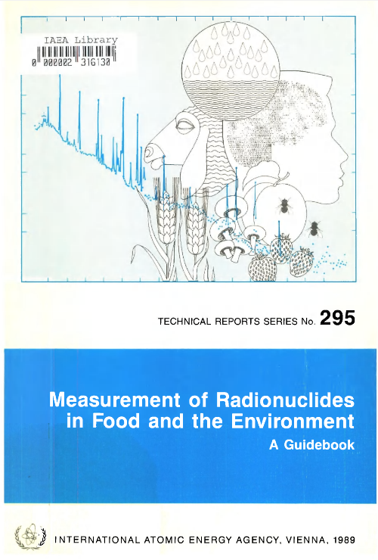
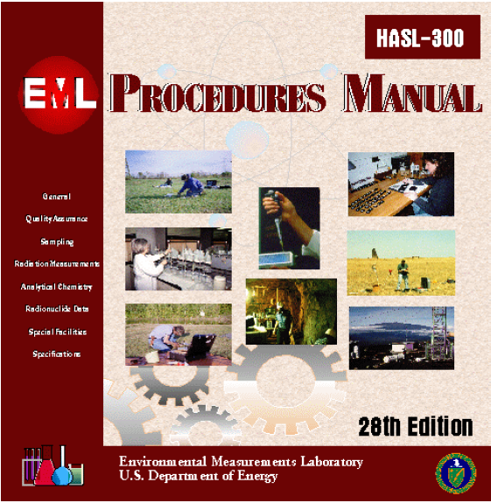
GUIDANCES

Slide 5
METHODOLOGY (Measurements)
  IAEA NS-R-3, Site Evaluation for Nuclear Installations, Safety Requirements, November 2003
 |  | AMBIENT RADIOACTIVITY
 |  | 4.15. Before commissioning of the nuclear installation the ambient radioactivity of the atmosphere, hydrosphere, lithosphere and biota in the region shall be assessed so as to be able to determine the effects of the installation. The data obtained are intended for use as a baseline in future investigations.
 |  | 6. QUALITY ASSURANCE
 |  | 6.1. An adequate quality assurance programme shall be established to control the effectiveness of the execution of the site investigations and assessments and engineering activities performed in the different stages of the site evaluation for the nuclear installation.

Slide 6
METHODOLOGY (Modeling)
  IAEA NS-G-3.2, Dispersion of Radioactive Material in Air and Water and Consideration of Population Distribution in Site Evaluation for Nuclear Power Plants, Safety Guide, March 2002
 |  | 2.3. Contamination in the air, on the ground and in water over short and long time periods should be described in the atmospheric dispersion models, with account taken of diffusion conditions in the region. Orographic elevations having significant slopes should be considered in the models.
 |  | 2.5. The effects and consequences for the public and the environment of short term or long term radioactive discharges should be assessed on the basis of meteorological information and site specific conditions relating to land and water uses, population distribution, infrastructure in the vicinity of the site and relevant radiological parameters.

Slide 7
METHODOLOGY (Modeling)
  IAEA NS-G-3.2, Dispersion of Radioactive Material in Air and Water and Consideration of Population Distribution in Site Evaluation for Nuclear Power Plants, Safety Guide, March 2002
 |  | 2.3. Contamination in the air, on the ground and in water over short and long time periods should be described in the atmospheric dispersion models, with account taken of diffusion conditions in the region. Orographic elevations having significant slopes should be considered in the models.
 |  | 2.5. The effects and consequences for the public and the environment of short term or long term radioactive discharges should be assessed on the basis of meteorological information and site specific conditions relating to land and water uses, population distribution, infrastructure in the vicinity of the site and relevant radiological parameters.

Slide 8
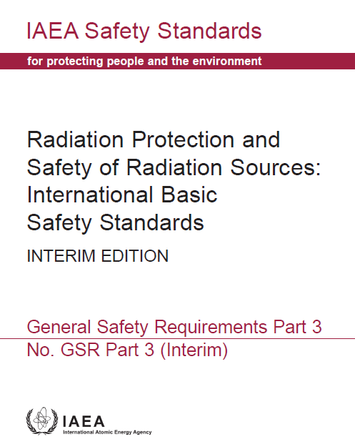
METHODOLOGY
Uncertainties in GRS Part 3 (new BSS)

Slide 9
METHODOLOGY
Uncertainties in GRS Part 3 (new BSS)
  Requirement 30:
  Responsibilities of relevant parties specific to public exposure
 |  | Relevant parties shall apply the system of protection and safety to protect members of the public against exposure.
 |  | 3.126. Registrants and licensees in cooperation with suppliers, in applying the principle of optimization of protection and safety in the design, planning, operation and decommissioning of a source (or for closure and the post-closure period for waste disposal facilities), shall take into account:
 |  | Uncertainties in the assessment of doses, especially uncertainties in contributions to doses if the source and the representative person are separated in space or in time.

Slide 10
METHODOLOGY
 |  | A Council of Ministers Regulation on the detailed scope of assessment of the location intended for a nuclear facility, the cases where such location must not be considered as meeting the requirements for location of the nuclear facility and on requirements for a location report for the nuclear facility (J.o.L. of 2012, item 1025)
  Assessment of baseline of environmental conditions in foreseen location of NPP is complex operation consist of meteorological, geological hydrogeological and radiological studies

Slide 11
METHODOLOGY
 |  | A Council of Ministers Regulation on the detailed scope of assessment of the location intended for a nuclear facility, the cases where such location must not be considered as meeting the requirements for location of the nuclear facility and on requirements for a location report for the nuclear facility (J.o.L. of 2012, item 1025)
  Radiological studies – environmental components
  Distribution of radionuclides in soil, surface water, ground water and air as well as spatial and temporal distribution of ambient dose rate.
  Radiological studies – spacial range
  Assessment for localization region i.e: >= 30 km

Slide 12
METHODOLOGY
One important purpose of the measurements is to provide data that permit the analysis and evaluation of human radiation exposure.
 |  | An exposure pathway defines routes from a source of radionuclides and/or radiation to a target individual or a population through media in the environment. two main categories of exposure pathway: external exposure pathways (the source of exposure remains outside the body) internal exposure pathways (the source of exposure is incorporated into the body)

Slide 13
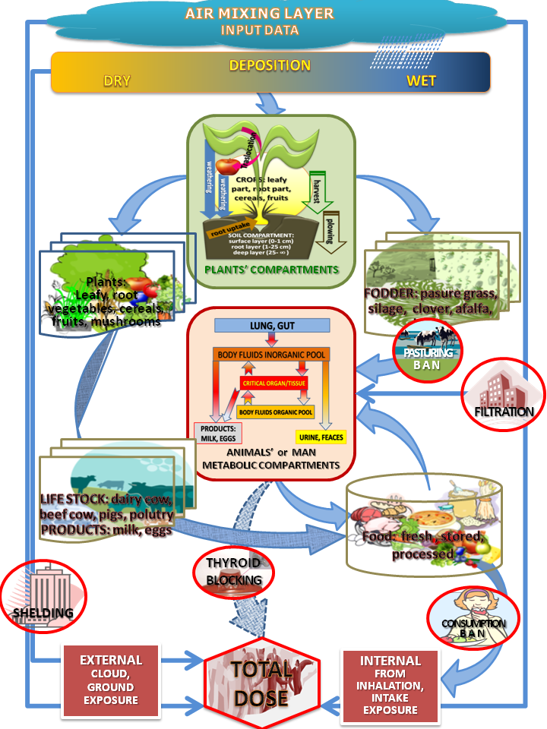
METHODOLOGY
The main external exposure pathways considered are:
 | 1 | Source of radiation → human: direct exposure from a source of ionizing radiation.
 | 2 | Source of radionuclides → atmosphere or water body → human: exposure due to the plume of radionuclides in the atmosphere (cloud shine) or water.
 | 3 | Source of radionuclides → atmosphere or water body → human skin: contact exposure from radionuclides on the skin.
 | 4 | Source of radionuclides → atmosphere or water body → soil or sediment or building surface or vegetation → human: exposure from the radionuclides deposited on the ground or on sediments (on the shores of rivers, lakes or the sea) or building surfaces (walls, roofs and floors) or vegetation (trees, bushes and grass).

Slide 14
METHODOLOGY
The main internal exposure pathways considered are:
 | 1 | Source of radionuclides → atmosphere → human: inhalation of radionuclides in the plume.
 | 2 | Source of radionuclides → atmosphere or water body → (soil or sediment) → vegetation and/or meat, milk, eggs or marine food → human: ingestion of radionuclides in food or beverages.
 | 3 | Source of tritium → atmosphere → human: for tritium oxide in the plume, absorption through the skin.
 | 4 | Soil or sediment → human: inhalation of resuspended radionuclides.

Slide 15
METHODOLOGY
The importance of the various exposure pathways depends on:
 |  | The radiological properties of the material released (e.g. gamma emitters, beta emitters or alpha emitters; physical half-life)
 |  | The physical (e.g. gas, liquid or solid) and chemical (e.g. organic or inorganic form, oxidation state, speciation, etc.) properties of the material and its migration characteristics.
 |  | The dispersal mechanism and factors affecting it (e.g. stack height, meteorological conditions, etc.) and environmental characteristics (e.g. climate, type of biota, agricultural production, etc.).
 |  | The locations, ages, diets and habits of the exposed individuals or population.

Slide 16
METHODOLOGY
An important concept of human radiation exposure is that of the ‘critical group’.
 |  | The critical group is defined as a group of members of the public which is reasonably homogeneous with respect to its exposure for a given radiation source and is typical of individuals receiving the highest effective dose or equivalent dose (as applicable) from the given source because of their location, age, diet or habits.
 |  | Dose constraints or, in some circumstances, dose limits established by the regulatory body generally apply to the mean dose to this critical group.
 |  | Adequate attention should be paid to the habits of ethnic and cultural minorities as well as those of indigenous people where applicable. Their living patterns and habits of consumption of food and water could give rise to pathways and elevated exposure levels that are unanticipated by conventional analysis.

Slide 17
METHODOLOGY
In the design of an environmental monitoring program, the environmental characteristics in the vicinity of a facility that need to be taken into account include, as appropriate:
 |  | Prevailing wind direction
 |  | Meteorological variations.
 |  | Current and future land use.
 |  | Agricultural practices.
 |  | Soil and hydrological properties.

Slide 18
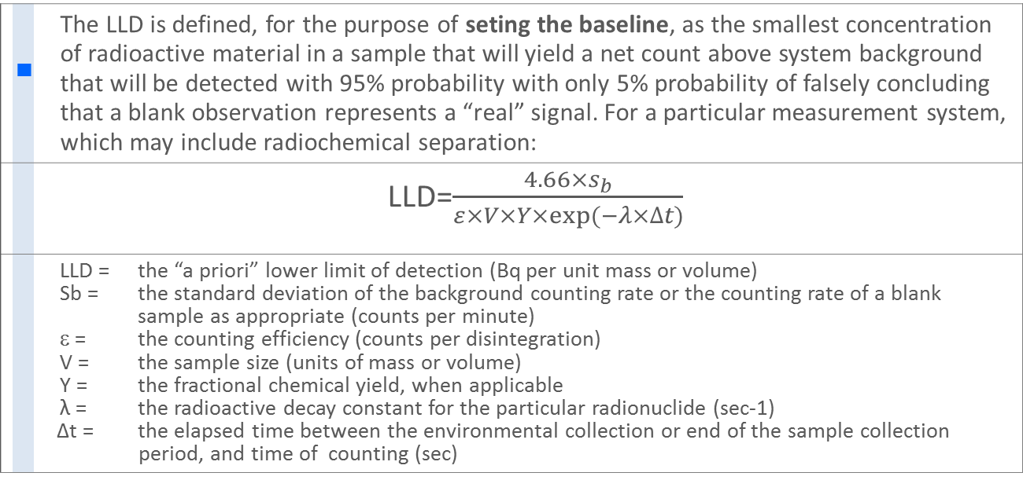
METHODOLOGY
The required detection capabilities for environmental sample analyses are expressed in terms of the lower limits of detection (LLDs)
 |  | The LLD is defined, for the purpose of seting the baseline, as the smallest concentration of radioactive material in a sample that will yield a net count above system background that will be detected with 95% probability with only 5% probability of falsely concluding that a blank observation represents a “real” signal. For a particular measurement system, which may include radiochemical separation:
 |  | LLD=$\frac{4.66×s_{b}}{ε×V×Y×exp⁡(−λ×∆t)}$
 |  | LLD = the “a priori” lower limit of detection (Bq per unit mass or volume) Sb = the standard deviation of the background counting rate or the counting rate of a blank sample as appropriate (counts per minute) ε = the counting efficiency (counts per disintegration) V = the sample size (units of mass or volume) Y = the fractional chemical yield, when applicable λ = the radioactive decay constant for the particular radionuclide (sec-1) Δt = the elapsed time between the environmental collection or end of the sample collection period, and time of counting (sec)

Slide 19
METHODOLOGY
Required detection capabilities for thermoluminescence dosimeters used for environmental measurements shall meet or exceed the following recommendations:
 |  | The performance of the TLD system shall be determined under laboratory conditions and in a known radiation field with an exposure equal to that resulting from an exposure rate of 10 nGy/hr during the field cycle. Ninety-five per cent of the measurements shall fall within 10% of the known exposure.
 |  | Ninety-five percent of the final values (after all appropriate corrections to the measurements are applied, including those for errors expected under field conditions) shall differ from the correct value by less than 30% of the correct value
 |  | Uniformity shall be determined by giving TLDs from the same batch an exposure equal to that resulting from an exposure rate of 10 nGy/hr during the field cycle. The response obtained shall have a relative standard deviation (coefficient of variation) of less than 7.5%.
 |  | Reproducibility shall be determined by giving one TLD repeated exposures equal to that resulting from an exposure rate of 10 nGy/hr during the field cycle. The responses shall have a relative standard deviation (coefficient of variation) of less than 3.0%."

Slide 20
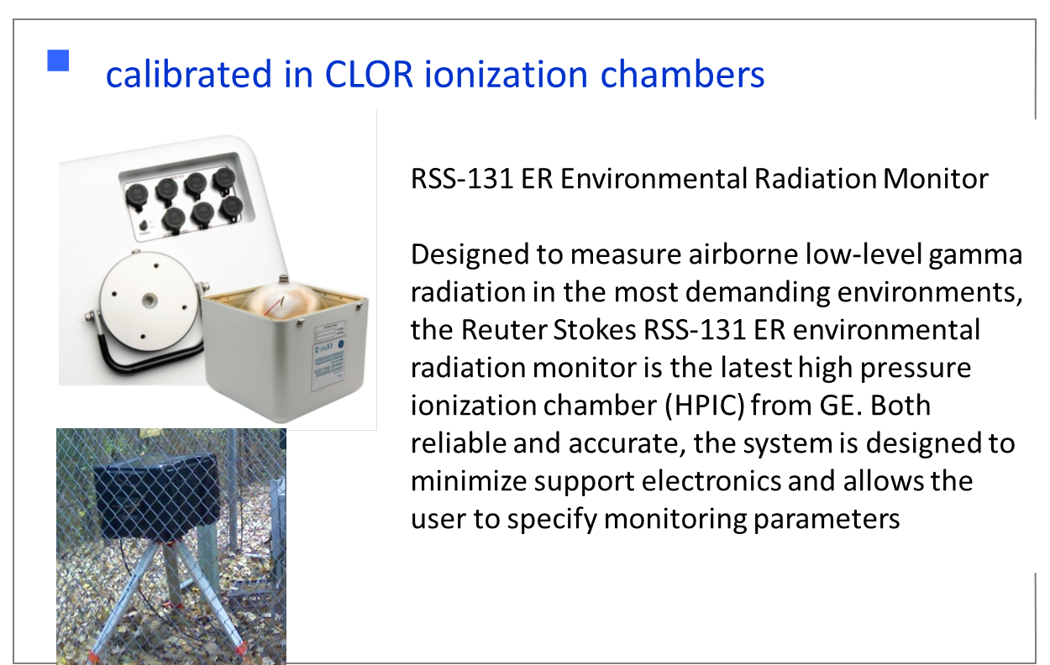
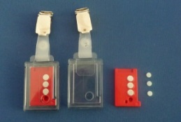
EQUIPMENT
Gamma dose rate measurement
Remote control and compatible with many externally mounted wireless radio options
Passive method TLD

Slide 21
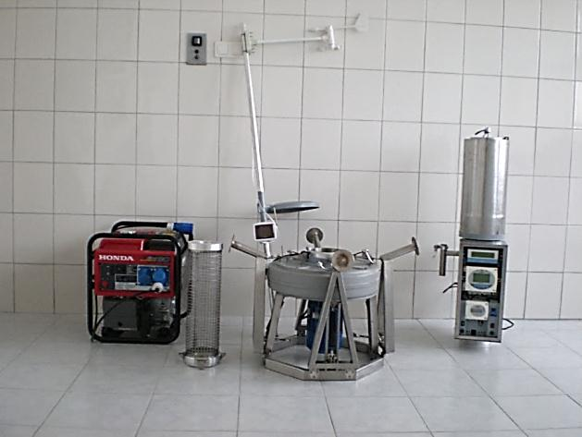
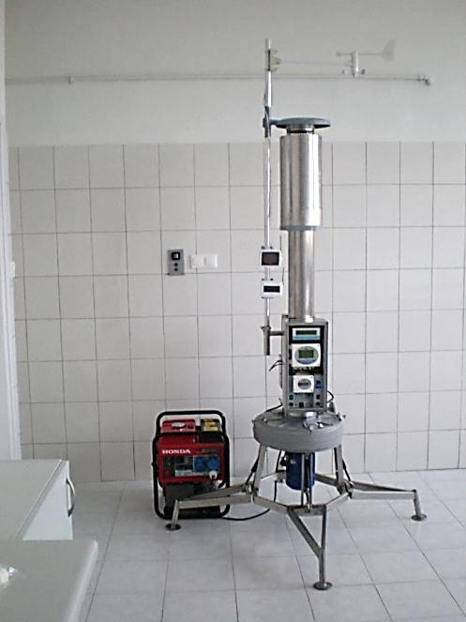
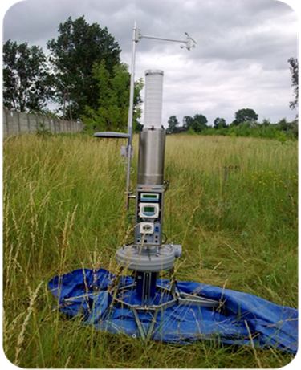
EQUIPMENT
Air monitoring
  HIGH-SENSITIVE MOBILE STATION
New patented by CLOR mobile station for monitoring (sampling and on-line measurements) airborne radioactive contaminations.
(1000 m3 per h) for measurements air radioactive contaminations base on LaBr₂ detector, with meteo station, integrated with computer network, full long distance controlled and data transmission via wifi connector.

Slide 22
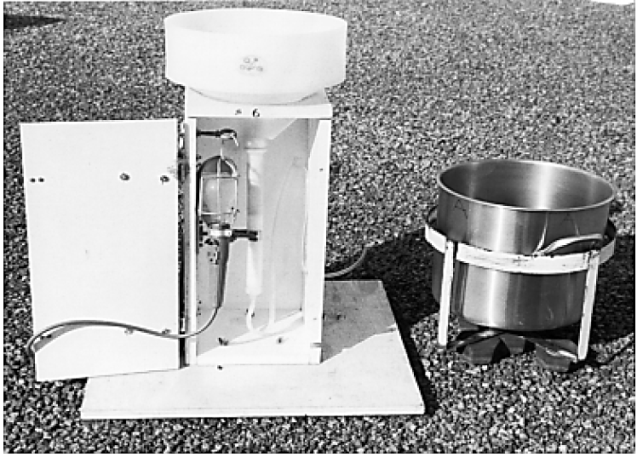
EQUIPMENT
Deposition
Ion-exchange fallout collection and fallout pot collector.

Slide 23
EQUIPMENT
Soil samples undisturbed (unploughed) area of ground,
agricultural soil as part of a program to study the ingestion pathway
  SOIL monitoring- supported by the National Environmental Protection and Water Management Fund
  the fourth edition of “Radiation Atlas of Poland, 2011” released in 2012
¹³⁷Cs deposition in the 10 cm surface layer of soil in Poland, in October 2011

Slide 24
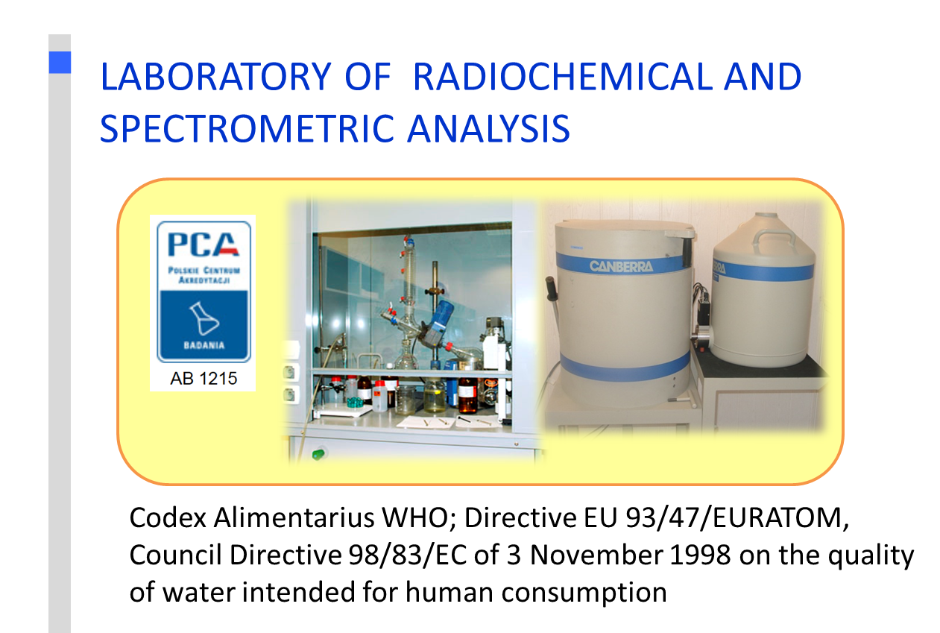
EQUIPMENT
Foodstuffs, pasture
Milk (from cow, goat or sheep) other animal food products should be monitored as appropriate based on local diet.
Terrestrial Indicator Samples: lichen, moss, leaves, pine needles, etc.
not appropriate for the purpose of determining the dose to members of the public from discharges of radionuclides from a facility. they provide information on trends and environmental accumulation.

Slide 25
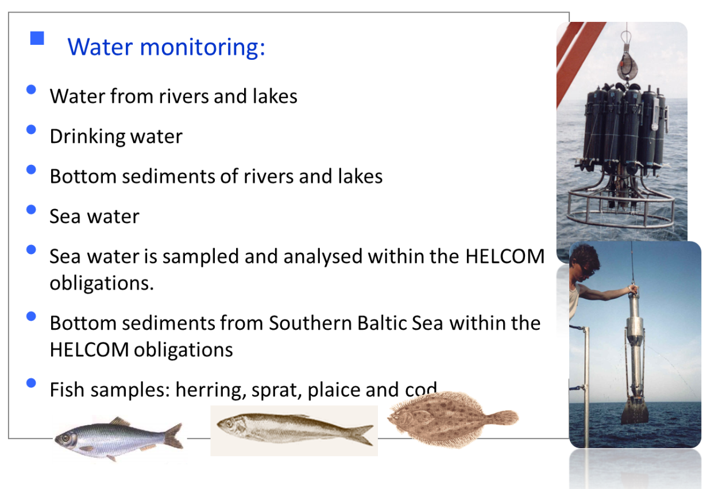
EQUIPMENT
Aquatic Environments
Sediments, Aquatic biota of interest includes fish (both pelagic and benthic), shellfish (mollusk and crustacean) and plants (mainly seaweed in sea water). bio-indicators for certain radionuclides (mollusks, seaweed) and/or part of the terrestrial food chains (seaweed used as fertilizers).
Aquatic Indicator samples- may not necessarily give rise to exposure of members of the public, but they may be used to monitor short term and long term trends in radionuclide concentrations in the aquatic environment. Indicators that might be used include plants, algae, benthic animals and inorganic materials (e.g. suspended particulate matter)

Slide 26
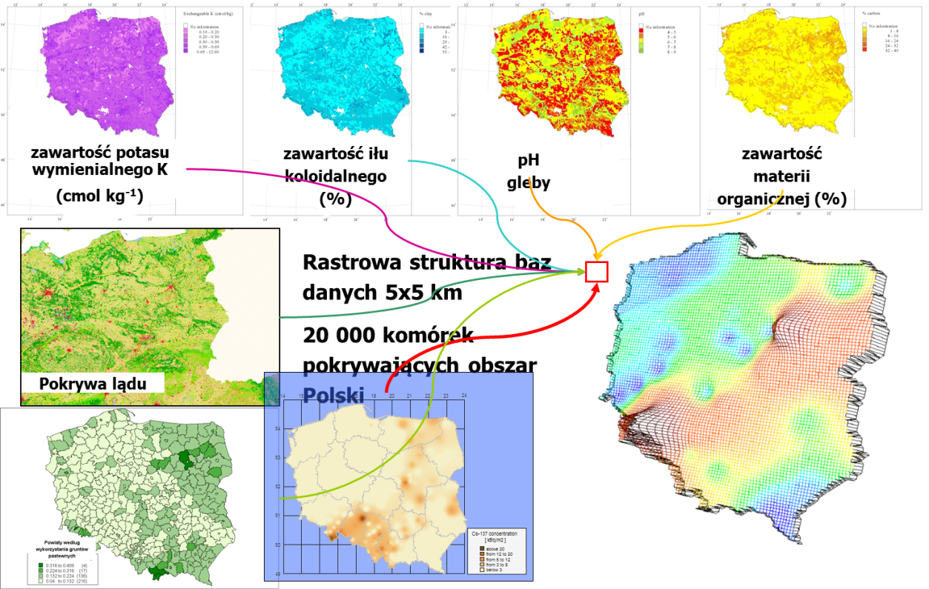
MAPPING
SPACIAL ANALYSIS OF VULNARABLE AREAS OF Cs-137 DEPOSITION (example)

Slide 27
MAPPING
SADA 2012, Spatial Analysis and Decision Assistance, The Institute for Environmental Modeling at the University of Tennessee, 2012 .
Multi-Agency Radiation Survey and Site Investigation Manual (MARSSIM)
MARSSIM is a regulatory guidance document that provides detailed guidance for planning, implementing and evaluating environmental and facility radiological surveys.

Slide 28
MAPPING
SADA 2012, Spatial Analysis and Decision Assistance, The Institute for Environmental Modeling at the University of Tennessee, 2012 .
 |  | Sample Designs
 |  | Initial sample designs are used to create first round sampling designs. Secondary sample designs are used when sampled data and/or modeled results already exists and there i requirement to further refine understanding, model, or decision regarding the site.
 |  | Determining Number of Samples
 |  | The method for determining the number of samples will depend on the sample design selected. For a number of classic sample design that seek to control Type I or Type II errors in some future hypothesis test SADA provides a couple of non-parameteric ways to determine the number of new samples (sign test, and Wilcoxon rank sum test). Other geographically targted designs may require the minimization or maximization of some external cost-benefit function. Two classical approaches to determining the number of samples for in support of a future hypothesis test about whether the mean or median will exceed a decision

Slide 29
MAPPING
SADA 2012, Spatial Analysis and Decision Assistance, The Institute for Environmental Modeling at the University of Tennessee, 2012 .
 |  | Extrapolation od measurements results

Slide 30
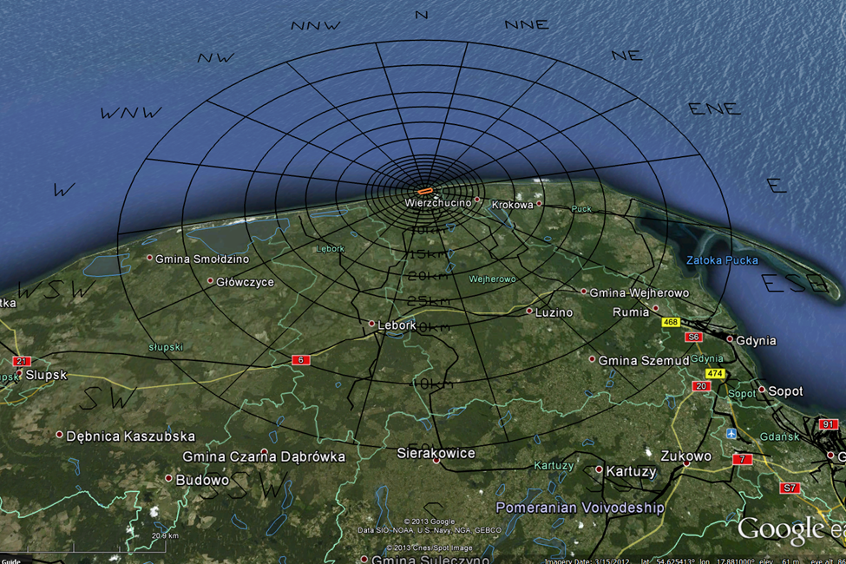
LOCATIONS
Choczewo Site with Wind Rose to 50 kms
WorleyParson:
DRAFT RADIOLOGICAL ENVIRONMENTAL MONITORING SAMPLING PROGRAM

Slide 31
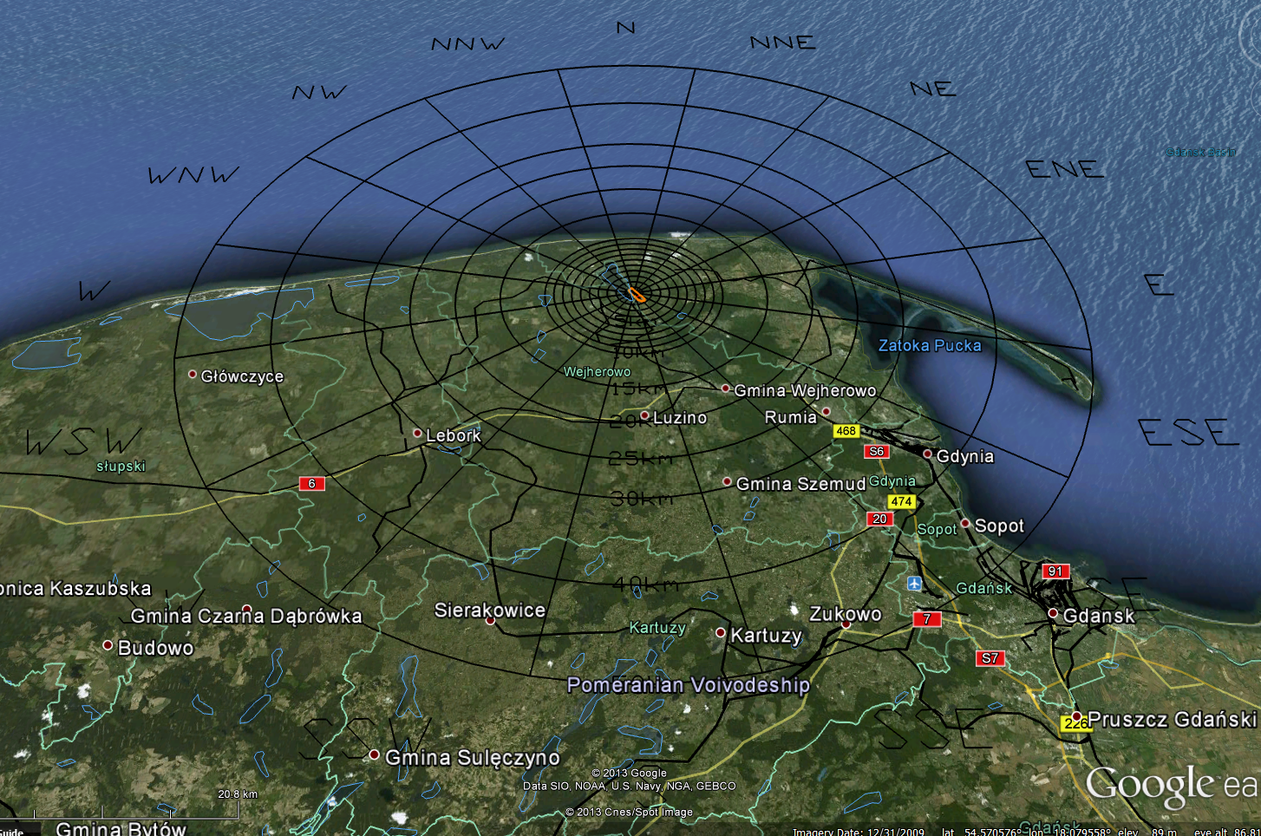
LOCATIONS
Zarnowiec Site with Wind Rose to 50 kms
WorleyParson:
DRAFT RADIOLOGICAL ENVIRONMENTAL MONITORING SAMPLING PROGRAM

Slide 32


DELIVERABLES

Slide 33
THANKS
FOR YOURS ATENTION
PAWEŁ KRAJEWSKI
CENTRAL LABORATORY FOR RADIOLOGICAL PROTECTION

